Slide 1
AI & FUTURE OF MARKETING
Dr. Ceren Kolsarici

Slide 2
Marketing

Slide 3
“Marketing is the generous act of helping someone solve a problem. Their problem. Marketing helps others become who they seek to become”. Seth Godin

Slide 4
ADVERTISING

Slide 5
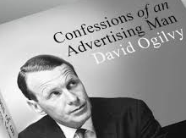
Ogilvy’s 7 Commandments
Give the facts.
Be truthful.
Be helpful.
Have a Big Idea.
Don't be boring.
Understand your customer.
Stay true to your brand.

Slide 6
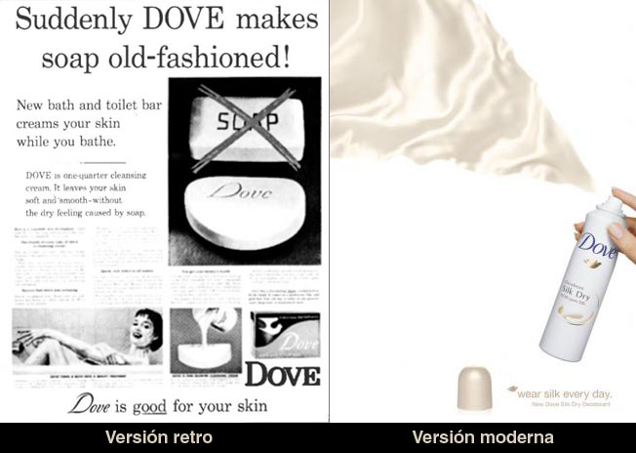
What does the product do? Who is it for?
“I could have positioned Dove as a detergent bar for men with dirty hands, but chose instead to position it as a toilet bar for women with dry skin. This is still working 25 years later.”

Slide 7
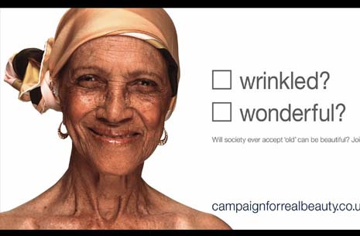
Dove fights for Real Beauty. Do you think that without its longstanding awareness campaign they would be so successful?

Slide 8
Artificial Intelligence

Slide 9
AI is about “Human-like” Intelligence
The term artificial intelligence was first coined by John
McCarthy in 1956 when he held the first academic
conference on the subject. But the journey to understand
if machines can truly think began much before that.
In Vannevar Bush’s seminal work As We May Think (1945)
he proposed a system which amplifies people’s own
knowledge and understanding. Five years later Alan
Turing wrote a paper on the notion of machines being able
to simulate human beings and the ability to do intelligent
things, such as play Chess (1950).
“History of Artificial Intelligence,” Chris Smith

Slide 10
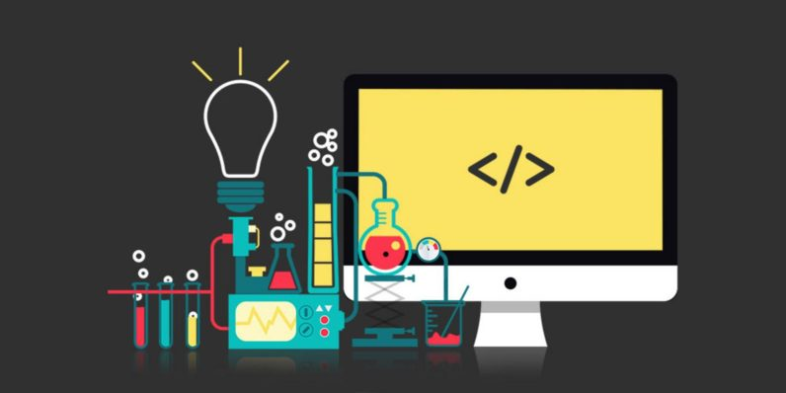
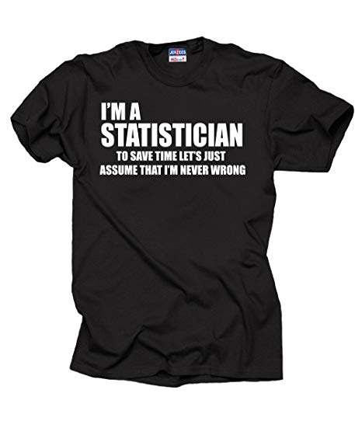

CS vs. Stats vs. ML

Slide 12
CS vs. Stats vs. ML
The defining questions of computer science are: How can we manually program computers to perform specific functions and solve problems, and which problems are inherently intractable?
The questions that largely define statistics are: What can we infer from historical information to predict the future? What conclusions can be inferred from data?
The defining questions for machine learning are: How can we build systems that automatically improve with experience? Can we get computers to decide for themselves what computational architectures and algorithms are most effective for manipulating data to reach a specific outcome?

Slide 13
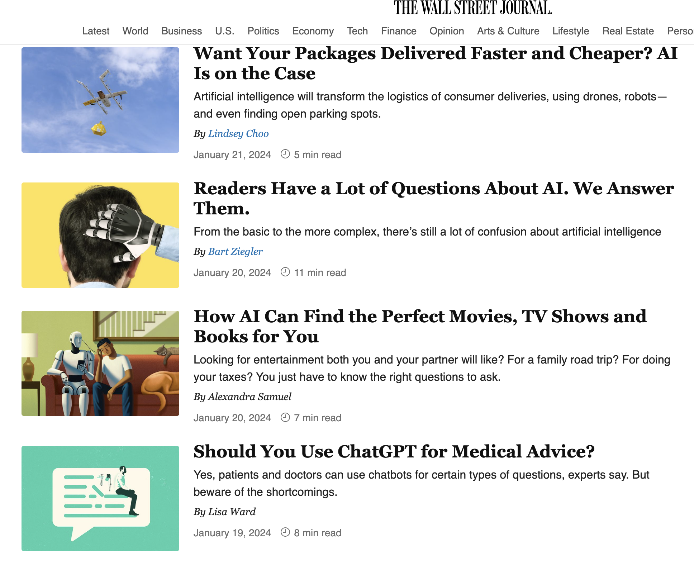
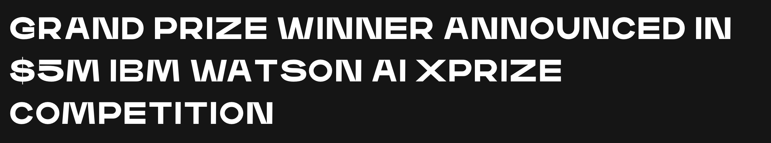
How AI Will Change Everything…AI is a general purpose technology (GPT)
1. Malaria Prevention
2. Human Trafficking Prevention
3. Clinical Decision Support in Mental Health
…

Slide 14
AI is a general purpose technology (GPT)

Slide 15

How can we explain the rise in AI?

Slide 16
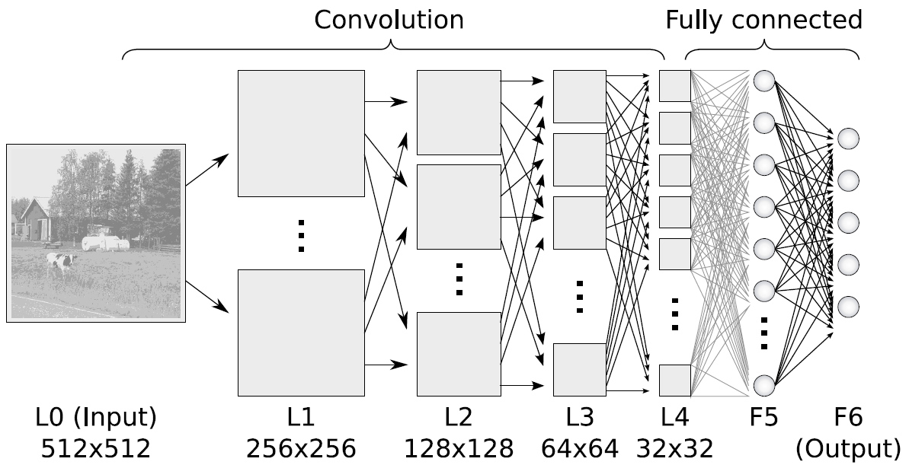
AI from the Lens of a Computer Scientist
Source: https://www.ais.uni-bonn.de/deep_learning/

Slide 17
AI from the Lens of an Economist
$
Cost of
Prediction
1950
2017

Slide 18
Boost in AI demand is a result of the drop in the cost of prediction
The current wave of advancements in AI does not actually bring us intelligence but a critical component of intelligence: prediction
Taking last five years’ sales data to predict sales next quarter
Using consumers’ engagement, demographic and behavioral data to predict churn rate
Looking at a medical image (pixels) to categorize a tumor as benign or malignant
Accounting only for consumers’ observable characteristics to predict their segment membership
Define the World as a Big Prediction Problem
Notes:
Using information that you do have to generate information that you don’t have

Slide 19

When the Cost of Prediction Falls
We use more of it (downward sloping demand curve)
Better, faster, cheaper
We use for other things by converting them into prediction problems to take advantage of the new cheap prediction

Slide 20

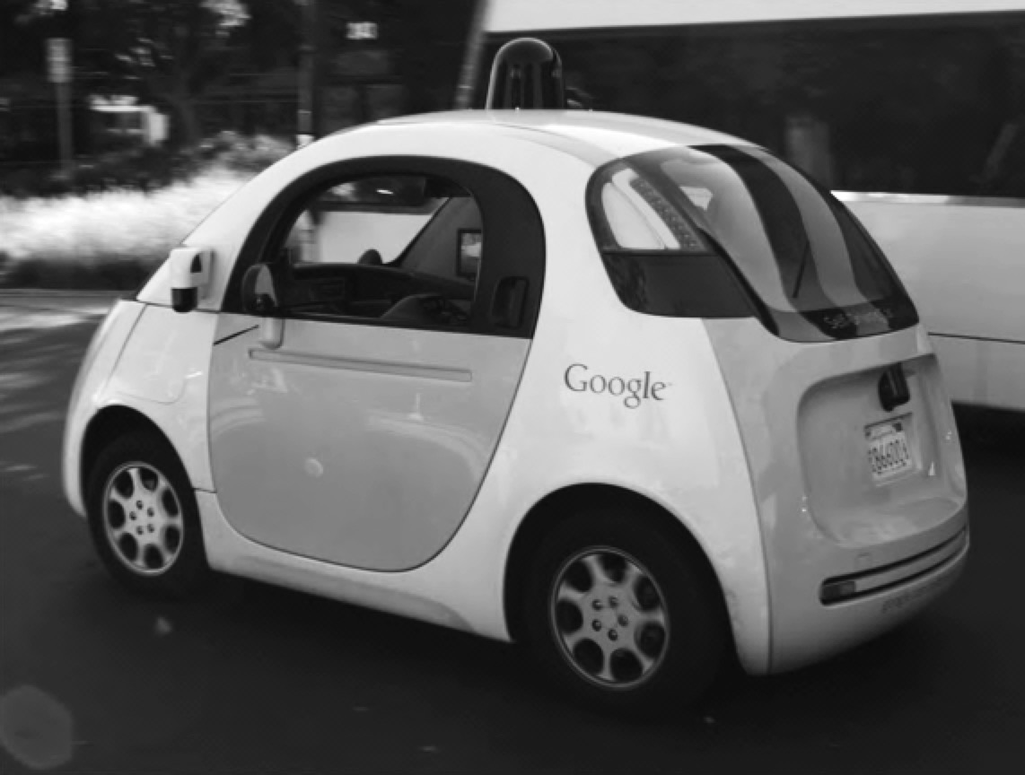
Expanding Range of Use as Input
Loan Pricing
Insurance Risk
Medical Diagnosis
Object classification
Autonomous vehicles

Slide 21
When the Cost of Prediction Falls
We use more of it (downward sloping demand curve)
Better, faster, cheaper
We use for other things by converting them into arithmetic problems to take advantage of the new cheap arithmetic
The cost of other things that relate to prediction are also affected

Slide 22

The Value of Other Things Get Affected
What are the substitutes and complements of AI?

Slide 23
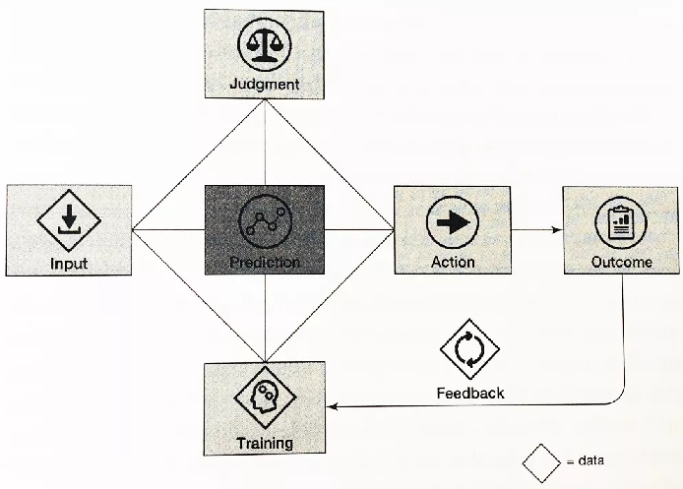
How AI’s rise impacts others depends on possibility of collaboration: AI replaces its substitutes and enhances its complements
Anatomy of a Task
Prediction feeds into decision making and decisions are everywhere
When cost of prediction matter enough, it can change strategy
General purpose technologies have the potential to transition from something interesting to something transformative
Allows firms to stay ahead of the curve
Source: Prediction Machines, Figure 7.1

Slide 24
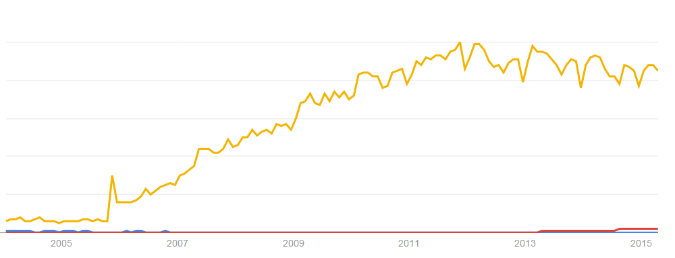
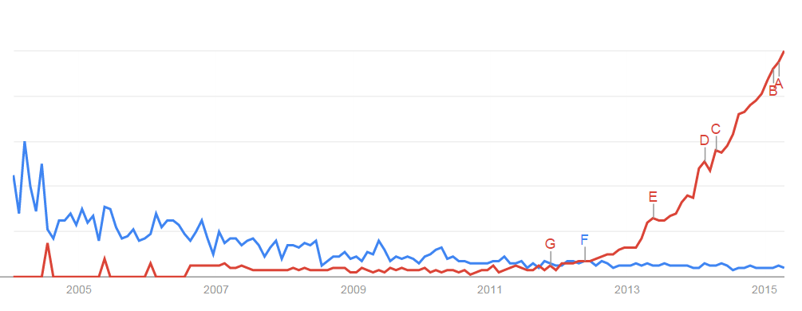
Data the “New” Oil, but Why?
Analytics
Marketing Science
Data Science
What makes data “new” today is that the same data is so much more valuable than it used to be

Slide 25
How AI’s rise impacts others depends on possibility of collaboration: AI replaces its substitutes and enhances its complements
Anatomy of a Task
Prediction feeds into decision making and decisions are everywhere
When cost of prediction matter enough, it can change strategy
General purpose technologies have the potential to transition from something interesting to something transformative
Allows firms to stay ahead of the curve
Source: Prediction Machines, Figure 7.1

Slide 26
Judgment
The process of determining what the reward is for a particular action in a particular environment.
OR
Ability to know what predictions to make and what to do with those predictions.
Figuring out the relative payoffs for different actions in different situations takes time, effort and experimentation

Slide 27
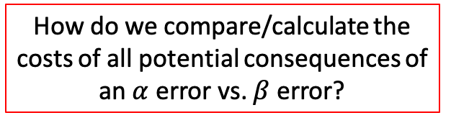
Judgment
How do we compare/calculate the costs of all potential consequences of an $α$ error vs. $β$ error?
Notes:
An innocent person behind bars, alpha error, false positive
Guilty person not convicted, beta error, false negative

Slide 28
Discussion
Can AI Improve in Judgment?

Slide 29
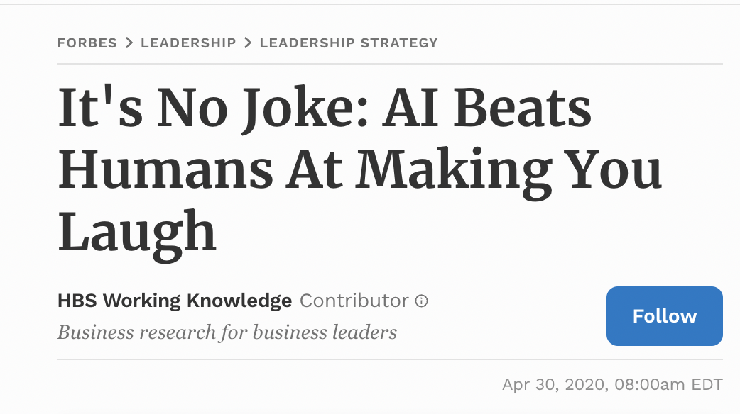
Collaborative Filtering
Notes:
The team enlisted 75 pairs of people, including spouses and close friends. Among the participants, 71 percent had known each other for longer than five years.

Slide 30
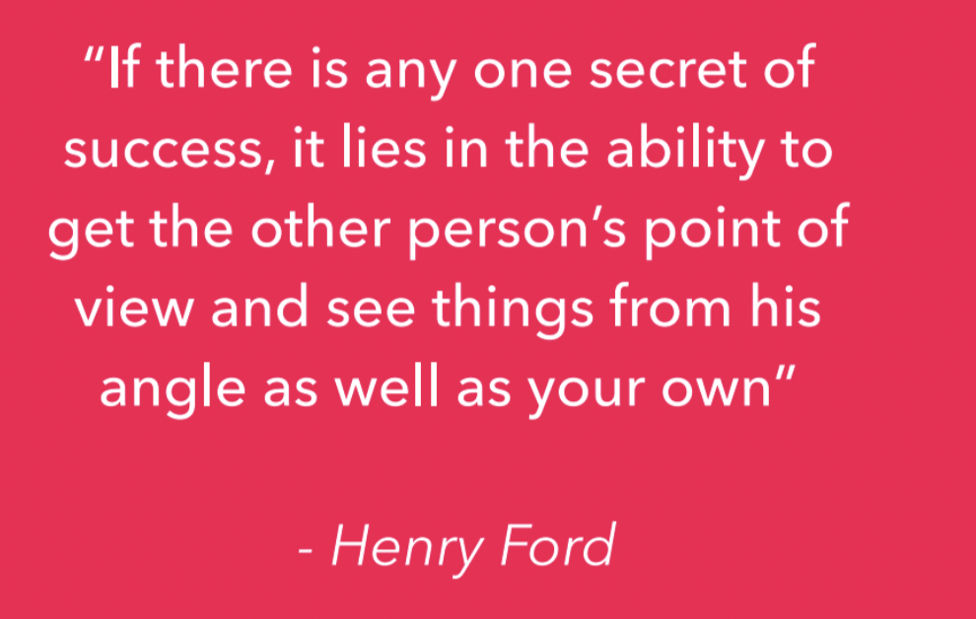
AI with Affective & Cognitive Empathy
Affective Empathy (Emotional Mirroring)
Cognitive Empathy (Perspective Taking)
Use Cases in therapy, counselling, focus groups, interviews, recruitment and many more.

Slide 31
A thought experiment

Slide 32
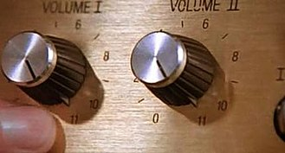

Slide 33
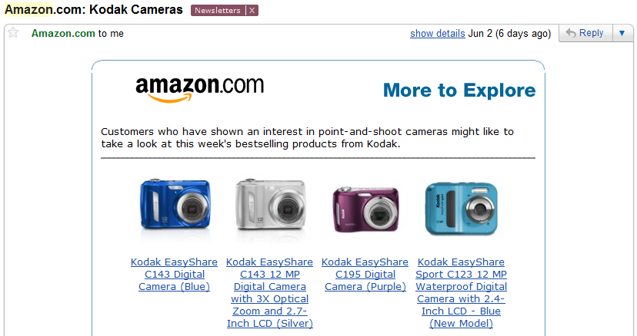

Slide 34

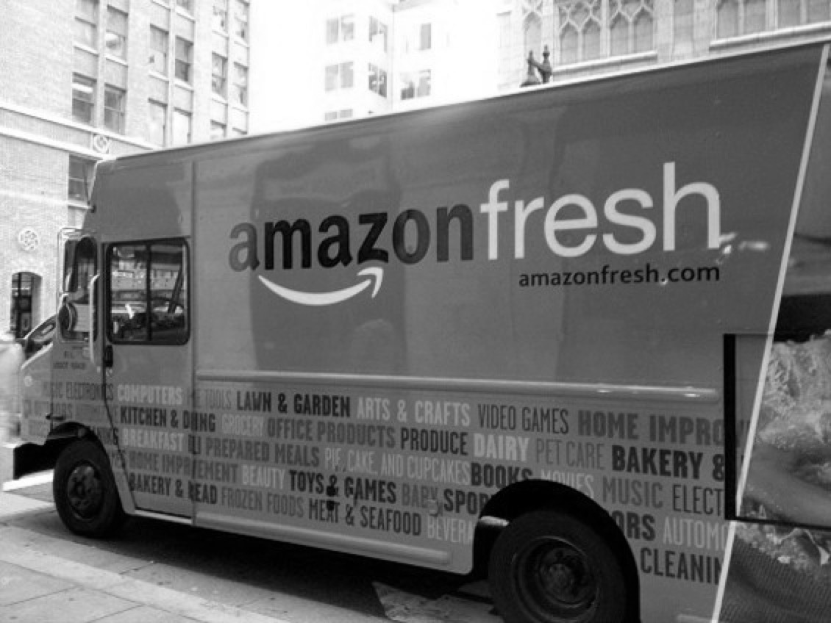


Slide 35
Disruption
Thought experiment is very powerful! Only parameter we changed is turning the knob, where nothing happens for a long time and then you hit a threshold and everything changes.

Slide 36
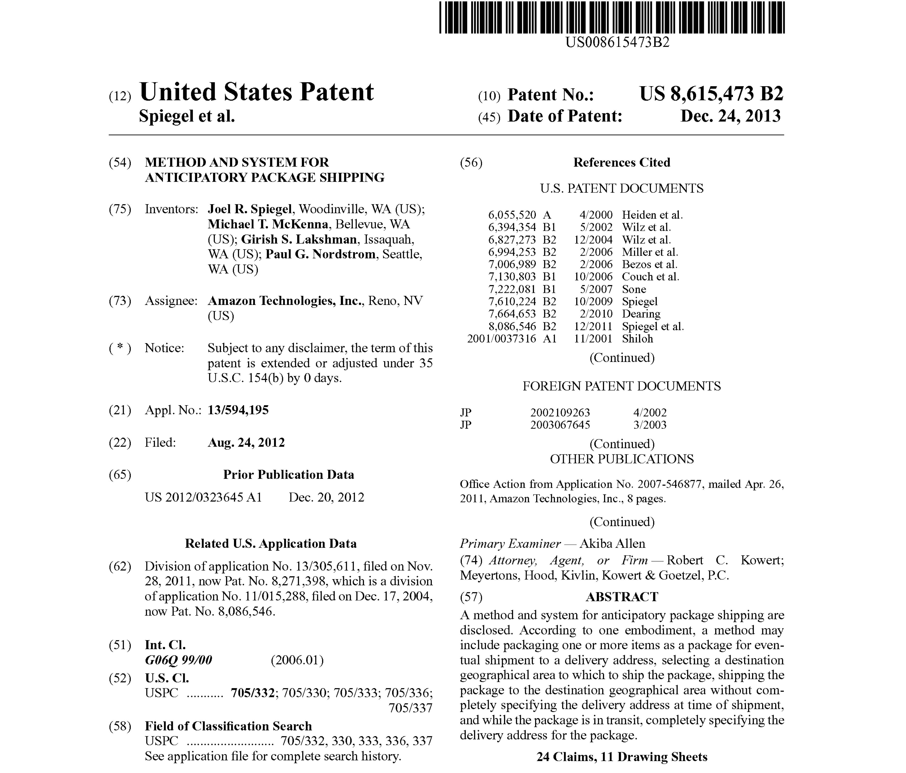

Slide 37
MarTech Fundamentals
Goals, Terminology and Landscape

Slide 38
We Need a New Division of Labor
ENTER YOUR JOB TITLE
____________________
Humans are terrible predictors
Cognitive biases are inherited, taught, and picked up by osmosis in a given culture (e.g. Familiarity Bias, Hindsight or Outcome Bias, Attribution Bias, Anchoring Bias, Availability Bias (the first example that comes to mind), Bandwagon Bias, Confirmation Bias)
Machines are terrible at all the other things complementary to prediction (e.g. Judgment)
”Human Zero” mindset is dangerous.
Create a “Human Plus” solution.
Source: “Will a Robot Take Your Job?” http://www.bbc.com/news/technology-34066941.
Better predictions are only possible when using human intuition with machine intelligence

Slide 39
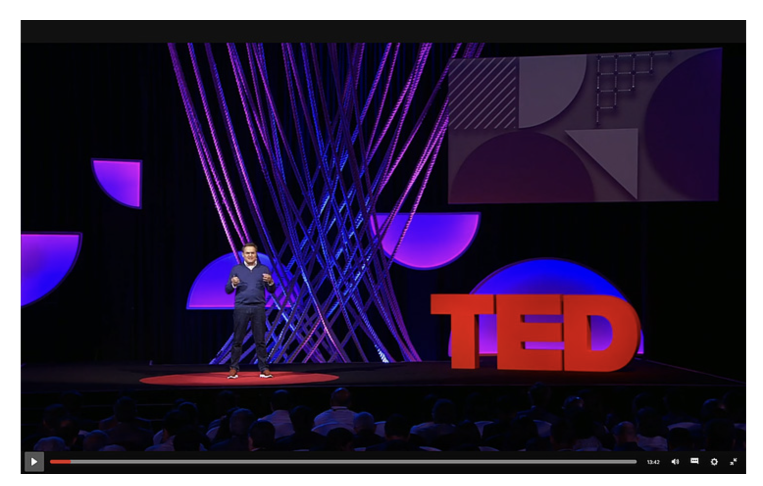
Aim for a “Human Plus” Mindset
Sylvain Duranton, Boston Consulting Group
Notes:
https://www.ted.com/talks/sylvain_duranton_how_humans_and_ai_can_work_together_to_create_better_businesses/transcript
Start at 7:59-11:25

Slide 40
Organizations Need Translators: People Who can Bridge Different Functional Areas
Marketing Insight
Math
&
Statistics
Computer Science
&
Coding

Slide 41
The New Marketing Ecosystem Marketing landscape is becoming increasingly complex and the decisions are becoming daunting for humans to execute alone with confidence

Slide 42
AI will impact both the Efficiency and Effectiveness of Marketing
The Marketing Holy Grail
Right Message
Right Person
Right Time
Marketing Success

Slide 43
MarTech (stack) refers to the tools used to streamline marketing processes, collect and analyze customer data, and provide means of reaching and engaging with your audience
MarTech
AdTech
AdTech refers to the technologies that make automated ad buying and selling possible

Slide 44
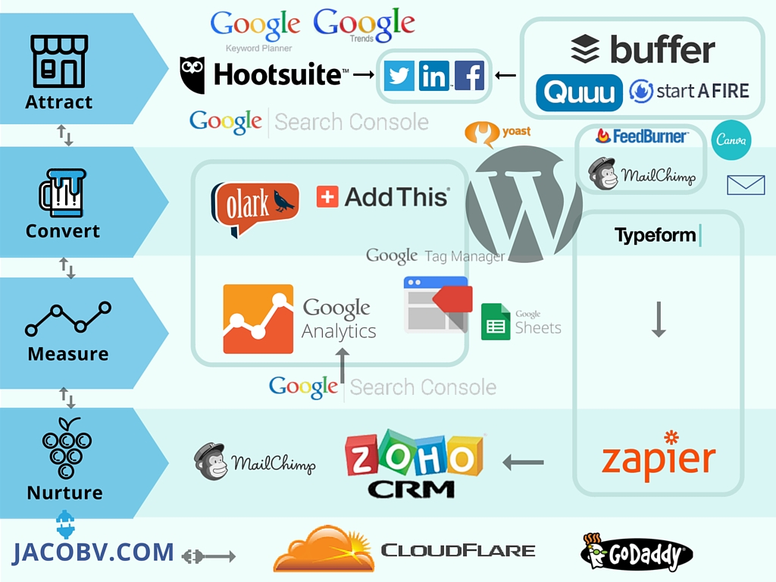
MarTech Stack Design is Unique to Each Firm but Ideally…
MarTech Stack aligns with the entire customer purchase funnel to help with:
Site and app analytics (collection and analysis of web and app data to understand and optimize consumer usage)
Owned activation channels (marketing platforms that are leveraged to boost unpaid marketing activities)
Customer data platforms (enhancing and personalizing communication with customers)
Marketing automation (any tools that are used to ingest, store, process, analyze or report on marketing activities)

Slide 45
The Role of AI in the Marketing Ecosystem
If you could aggregate and visualize your prospects’ behavioral
data, you could tell where you needed to pay attention based on the
shape of the resulting consumer purchase funnel.
AI helps you accomplish exactly that!

Slide 46
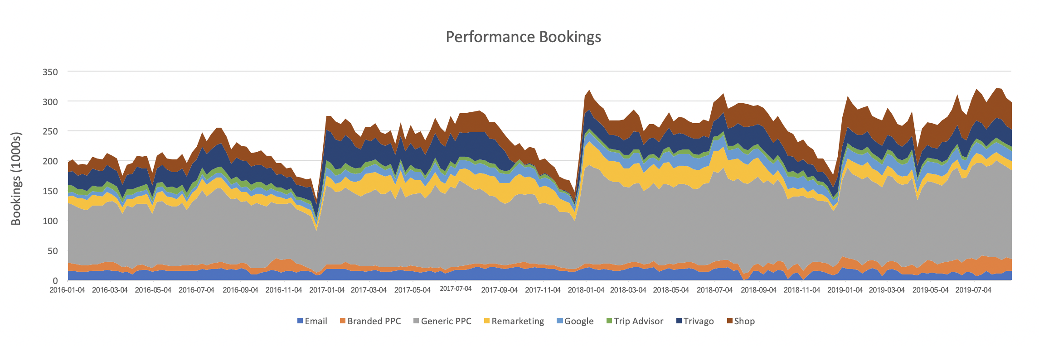
Top Use Cases for AI in Marketing
Notes:
Search, Recommendation systems, programmatic advertising, forecasting, conversational marketing, dynamic creative optimization, voice marketing, competitive intelligence
Product recommendations based on facial recognition
Personalized messaging
Redemption of loyalty points based on voice recognition
Campaign tailoring and optimization

Slide 47
Marketing Ranked High for AI-driven Disruption
AI has a broad potential across industries
Marketing AI applications are consistently rated highly based on both impact and data richness
AI applications have a very high ROI in marketing

Slide 48
Performance Measurement Comes First
“What is the measure of success? How do you set a budget for something that is so…so…fuzzy as marketing and branding” (Any CEO anywhere)
Marketing, too often, is perceived as a "cost" to the company than an "investment".
Marketing budgets are the first in line when it comes to budget cuts and last when it comes to source of long-term growth.
Bizarre? Yes!
Who to blame?
Marketers are, and should be, accountable for their decisions.
Data, analytics and AI are the great tools we have measuring and improving marketing performance; justifying and revising strategic and tactical plans.

Slide 49
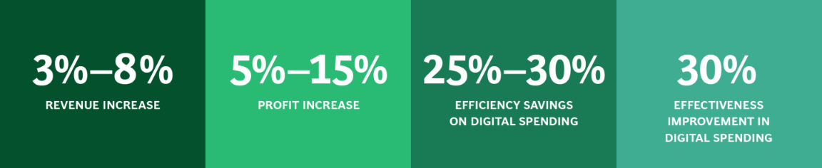
Harness the Power of Data and Analytics for Marketing Performance
Marketing catalyst approach to tackle strategic, tactical and digital challenges
Gauge marketing initiative’s impact more precisely
Integrated marketing analytics approach can save 15 to 20 percent of marketing spend (equates to $200B worldwide) with an increased marketing effectiveness. (www.mckinsey.com/business-functions/marketing-and-sales/our-insights/using-marketing-analytics-to-drive-superior-growth)
Source: https://www.bcg.com/capabilities/marketing-sales/marketing-catalyst
Notes:
Source: https://www.mckinsey.com/business-functions/marketing-and-sales/our-insights/using-marketing-analytics-to-drive-superior-growth

Slide 50


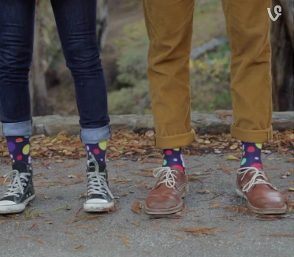
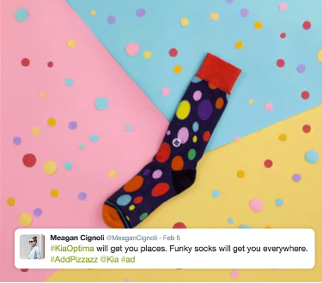
Example: KIA Influencer Marketing
Find influencers with traits associated with their Optima model: openness to change, artistic interest, and achievement-striving
Up to 30% increase in engagement for sponsored posts

Slide 51
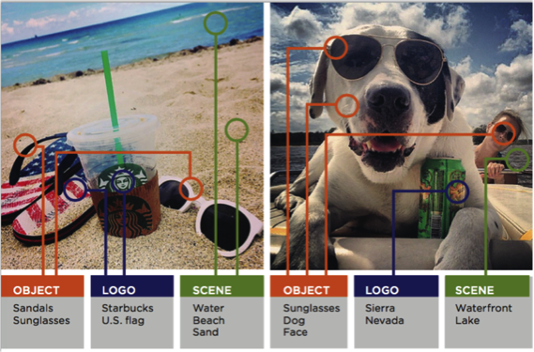
Example: Visual Listening for Competitor Intelligence
Monitor user-generated images through social media platforms and review boards to improve products and quality of service, and to attain intelligence about product usage/opinions.

Slide 52
AI & Analytics Leads to Significant Improvement in the Bottom Line
Systematic marketing decision making can improve marketing productivity by 5-10% with minimal additional costs (i.e. it has a very high ROI)
Zone of Death
Zone of Exceptional
Wish Marketing
Marketing
(Below
(Above
Average)
(Average
Average)
(Well
(Well Below
marketing
Above
Average)
program)
Average)
Marketing Performance
Critical
Troubling
Average
Pleasing
Amazing
Marketing Share Growth
Precipitous
Significant
Modest
Increase
Dramatic
Decline
Decline
Decline
Increase
New Product Success Rate
0%
5%
10%
25%
40%+
Advertising ROI
Negative
0%
1
20%
-
4%
5
-
10%
Promotional Programs
Disaster
Un
Very Profitable
-
profitable
Marginally Unprofitable
Profitable
Customer Satisfaction
90
-
0
95%
-
59%
60
-
69%
70
-
79%
80
-
89%
Customer Retention/Loyalty
90
-
0
94%
-
44%
45
-
59%
60
-
74%
75
-
89%
Data-driven actionable insights!
Figure Source: Marketing Engineering by Lillien G. L. and Arvind Rangaswamy, 2008

